Slide 1
UNIT-III
Transmission media & switching
Notes:
Br

Slide 2
List of Topics
Transmission Media:
Guided Media
Unguided Media: Wireless
Switching
Circuit-Switched Networks
Datagram Networks
Virtual-Circuit Networks
Structure of a Switch

Slide 3
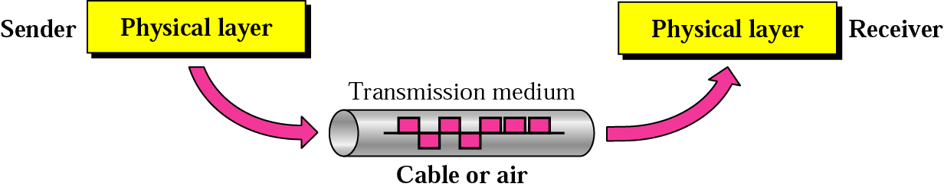
Introduction
Transmission media are actually located below the physical
layer and are directly controlled by the physical layer.
We can say that transmission media belong to layer zero.
Fig. Transmission Medium & Physical Layer

Slide 4

A transmission medium can be broadly defined as anything that can carry information from a source to a destination.
In data communications, transmission media can be divided into two broad categories:

Slide 5
Guided Media
Guided media, provide a physical channel from one
device to another.
Twisted-pair and coaxial cable use metallic (copper)
conductors that accept and transport signals in the
form of electric current.
Optical fiber is a cable that accepts and transports
signals in the form of light.

Slide 6
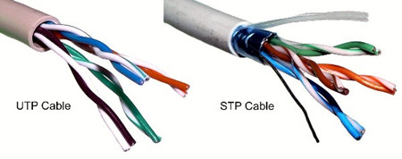
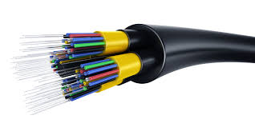
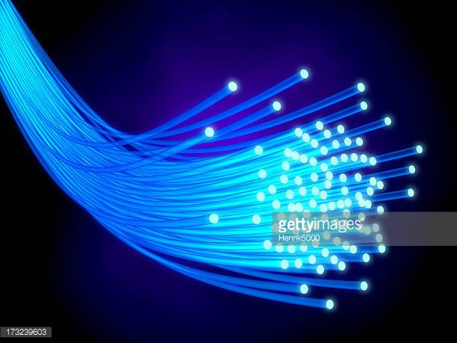
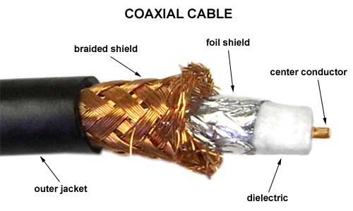
Images of cables

Slide 7
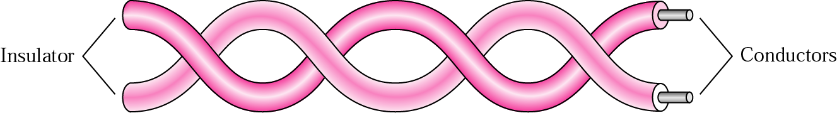
Guided Media - TPC
A twisted pair consists of two conductors, each with its
own plastic insulation, twisted together.
One of the wires is used to carry signals to the receiver,
and the other is used only as a ground reference.
The receiver uses the difference between the two.
Fig. Twisted-pair Cable

Slide 8
In addition to the signal sent by the sender on one of
the wires, interference (noise) and crosstalk may affect
both wires and create unwanted signals.
Twisting makes it probable that both wires are equally
affected by external influences (noise or crosstalk).
The no. of twists per unit of length (e.g., inch) has some
effect on the quality of the cable.

Slide 9

TPC - UTP and STP Cables
Unshielded twisted-pair (UTP) – most commonly used
Shielded twisted-pair (STP)
- produced by IBM
- has a metal foil or braided mesh covering that encases each pair of
insulated conductors.
- although metal casing improves the quality of cable by preventing the
penetration of noise or crosstalk, it is bulkier and more expensive.

Slide 10
Categories of UTP Cables
The Electronic Industries Association (EIA) has developed standards to
classify UTP cable into seven categories.
Categories are determined by cable quality, with 1 as the lowest and 7
as the highest.
Category | Data Rate (Mbps) | Use
1 | < 0.1 | Telephone
2 | 2 | T-1 lines
3 | 10 | LANs
4 | 20 | LANs
5 | 100 | LANs
5E | 125 | LANs
6 | 200 | LANs
7 | 600 | LANs

Slide 11

UTP Connector
RJ45 (RJ stands for registered jack) – most commonly used
It is a keyed connector, meaning the connector can be inserted in only one way.

Slide 12

UTP Performance
Fig. shows that with increasing frequency, the attenuation, measured in dB/km, sharply increases with frequencies above 100kHz.
Gauge – measure of the thickness of the wire.

Slide 13
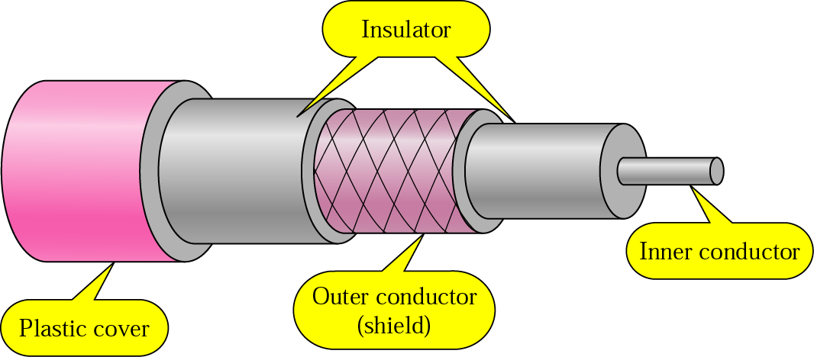
Coaxial Cable
Carries signals of higher frequency ranges than those in twisted-pair cable.
Has a central core conductor of solid or stranded wire (usually copper) enclosed in an insulating sheath, which is, in turn, encased in an outer conductor of metal foil, braid, or a combination of the two.
This outer conductor is also enclosed in an insulating sheath, and the whole cable is protected by a plastic cover.
Outer metallic wrapping serves both as a shield against noise and as the second conductor.

Slide 14

Coaxial Cable Standards
Coaxial cables are categorized by their radio government (RG) ratings.
Each RG no. denotes a unique set of physical specifications, including the wire gauge of the inner conductor, the thickness and type of the inner insulator, the construction of the shield, and the size and type of the outer casing.

Slide 15

Coaxial Cable Connectors
To connect coaxial cable to devices, we need coaxial connectors.
Bayone-Neil-Concelman (BNC) connector – most commonly used
BNC connector is used to connect the end of the cable to a device, such as a TV set.
BNC T connector is used in Ethernet networks.
BNC terminator is used at the end of the cable to prevent the reflection of the signal.

Slide 16

Coaxial Cable Performance
Attenuation is much higher in coaxial cable than in twisted-pair cable.
Requires frequent use of repeaters.

Slide 17
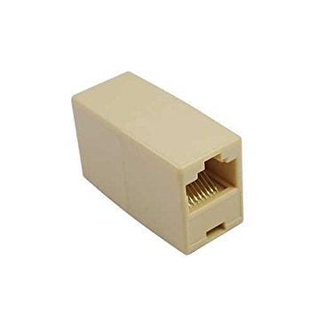
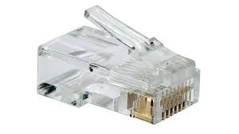
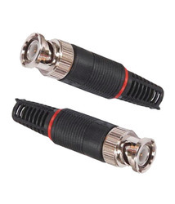
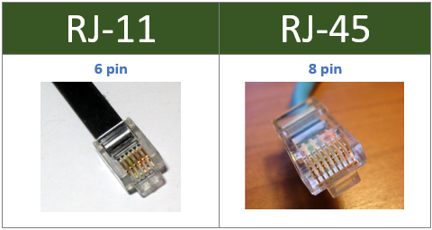
Images of RJ and BNC Connectors
BNC Connector

Slide 18
Fiber-Optic Cable – Working principle
It is made of glass or plastic
It transmits signals in the form of light
Aspects of the Nature of Light
Light travels in a straight line as long as it is moving through a single uniform substance.
If a ray of light traveling through one substance suddenly enters another substance (of a different density), the ray changes direction.
Fig. shows how a ray of light changes direction when going from a more dense to a less dense substance.

Slide 19
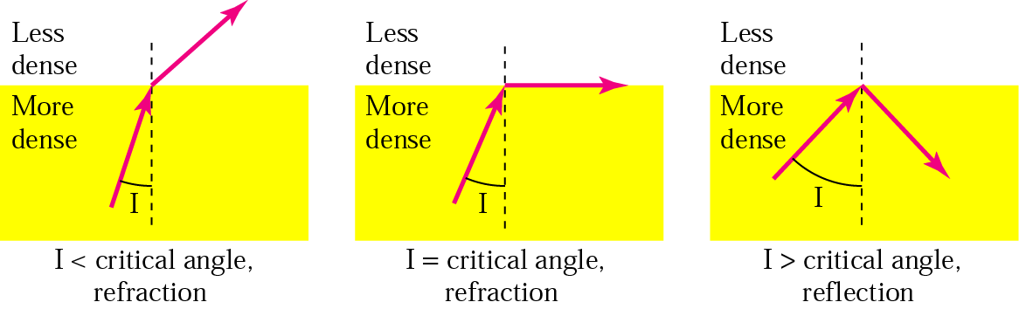
Angle of Incidence(I): the angle the ray makes with the line perpendicular to the interface between the two substances.
If I < critical angle, the ray refracts and moves away from the interface.
If I = critical angle, the ray bends along the interface.
If I > critical angle, the ray reflects and travels again in the denser substance.
Bending of Light Ray

Slide 20

Critical angle is a property of the substance, and its value differs from one substance to another.
Optical fibers use reflection to guide light through a channel.
A glass or plastic core is surrounded by a cladding of less dense glass or plastic.
The difference in density of the two materials must be such that a beam of light moving through the core is reflected off the cladding instead of being refracted into it.
Optical Fiber

Slide 21
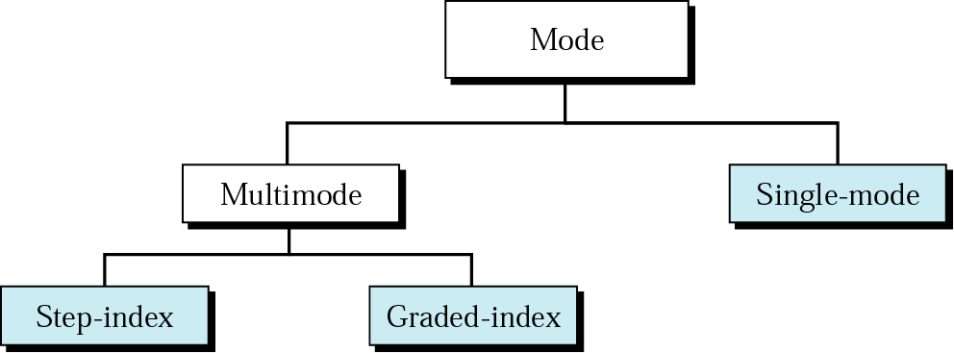
Fiber-Optic Cable – Modes of operation
Current technology supports two modes for propagating light along optical channels, each requiring fiber with different physical characteristics.
Propagation Modes

Slide 22
Multimode
Multiple beams from a light source move through the core in different paths.
In multimode step-index fiber, the density of the core remains constant from the center to the edges.
At the interface, there is an abrupt change due to a lower density; this alters the angle of the beam’s motion.

Slide 23
The term step index refers to the suddenness of this change, which distorts the signal as it passes through the fiber.
The multimode graded-index fiber decreases this distortion.
A graded-index fiber is one with varying densities, highest at the center of the core and decreases gradually to its lowest at the edge.

Slide 24
Singlemode
Single-mode uses step-index fiber and a highly focused source of light.
Single-mode fiber has a much smaller diameter than that of multimode fiber, and low density.
The decrease in density results in a critical angle that is close enough to 90⁰ to make the propagation of beams almost horizontal.
In this case, propagation of different beams is almost identical, delays are negligible. All the beams arrive at the destination “together” and can be recombined with little distortion to the signal.

Slide 25

Modes

Slide 26
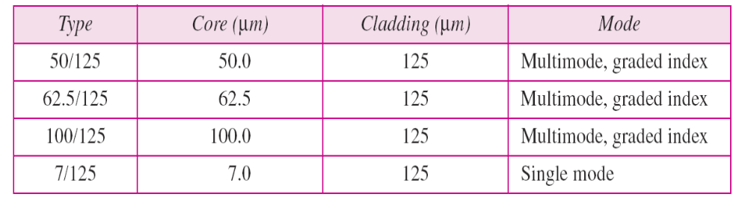
Fiber Types
Optical fibers are defined by the ratio of the diameter of their core to the diameter of their cladding, both expressed in µm.

Slide 27

Fiber Construction
Outer jacket is made of either PVC or Teflon.
Inside the jacket are Kevlar strands to strengthen the cable.
Below the Kevlar is another plastic coating to cushion the fiber.
The fiber is at the center of the cable, and it consists of cladding and core.

Slide 28

Fiber-optic Cable Connectors
SC (subscriber channel) connector used for cable TV. It uses push/pull locking system.
ST (straight-tip) connector used for connecting cable to networking devices. It uses a reliable bayonet locking system.
MT-RJ is the same size as RJ45

Slide 29

Optical Fiber Performance
Attenuation is flatter than in the case of twisted-pair cable and coaxial cable.
Needs fewer (actually 10 times less) repeaters

Slide 30
Advantages/Disadvantages of Optical Fiber
Advantages
  Higher bandwidth
  Less signal attenuation
  Immunity to electromagnetic interference
  Resistance to corrosive materials
  Light weight
  Greater immunity to tapping
Disadvantages
  Installation and maintenance
  Unidirectional light propagation
  Cost

Slide 31
Applications of Optical Fiber
Often found in backbone networks because its wide bandwidth is cost-effective.
- Cable TV
- LAN etc.

Slide 32
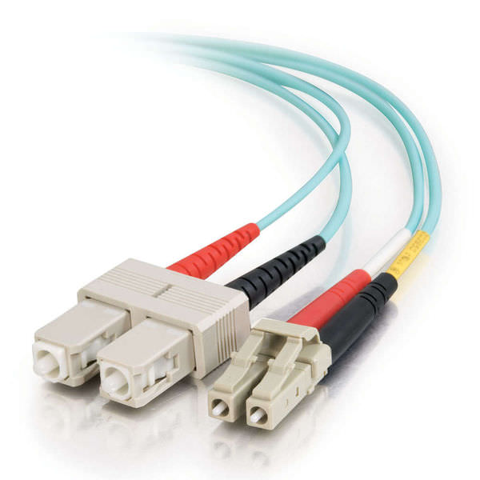
Image of Fiber optic cable connector

Slide 33
Summary
Twisted Pair Cable | Coaxial Cable | Fiber Optic Cable
Two conductors, each with It’s own plastic insulation, twisted together | A central copper conductor of solid or stranded wire enclosed in an insulating sheath, which in turn, encased in an outer conductor of metal foil, braid, or a combination of the two. This outer conductor is enclosed in an insulating sheath, and the whole cable is protected by a plastic cover | Outer jacket is made of either PVC or Teflon, inside of this Kevlar strands, below to it another plastic coating, inside of this the fiber consisting of both core and cladding
Two types are available: UTP, STP |  | Multimode step-index, multimode graded index, single mode step-index
1 to 5, 5E, 6 and 7 categories are available supporting increasing data rates | RG-59, RG-58, RG-11
RJ45 connectors | BNC connector, BNC T connector and BNC terminator | SC, ST and MT-RJ connectors
Used for Telephones, T1 lines, LANs (upto 600Mbps) | Used for Telephones(600Mbps), Cable TV, Thin and Thick Ethernet(10Mbps) | Used for Cable TV and LANs(1000Mbps); can go for 1600Gbps

Slide 34
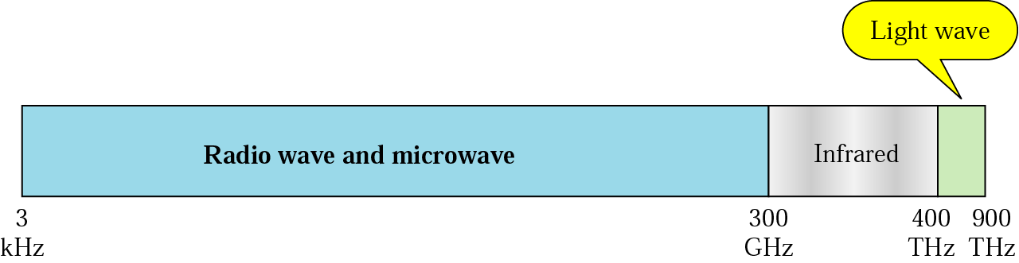
Unguided Media: Wireless
Transport signals without using a physical conductor.
Signals are transmitted in the form of ElectroMagnetic Waves.
Signals are sent through air and thus are available to anyone who has a device capable of receiving them.
Fig. shows a part of the electromagnetic spectrum, used for wireless communication.

Slide 35
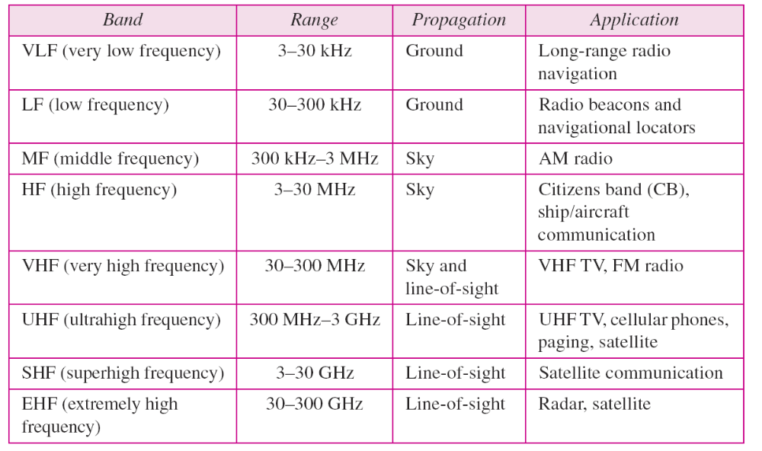
Frequency Bands

Slide 36
Propagation of Waves
Unguided signals can travel from the source to destination in several ways: ground propagation, sky propagation, and line-of-sight propagation.
Ground propagation:
- radio waves travel through the lowest portion of the
atmosphere, hugging the earth.
- low-frequency signals
- emitted in all directions from the transmitting antenna and
follow the curvature of the planet.
- greater the power, the greater the distance.

Slide 37
Sky propagation:
- high-frequency radio waves radiate upward into the ionosphere
(the layer of atmosphere where particles exist as ions) where
they are reflected back to earth.
- allows greater distances with lower output power.
Line-of-sight propagation:
- Very high-frequency are transmitted in straight lines directly
from antenna to antenna.
- antennas must be directional, facing each other, and either tall
enough or close enough together not to be affected by the
curvature of the earth.

Slide 38
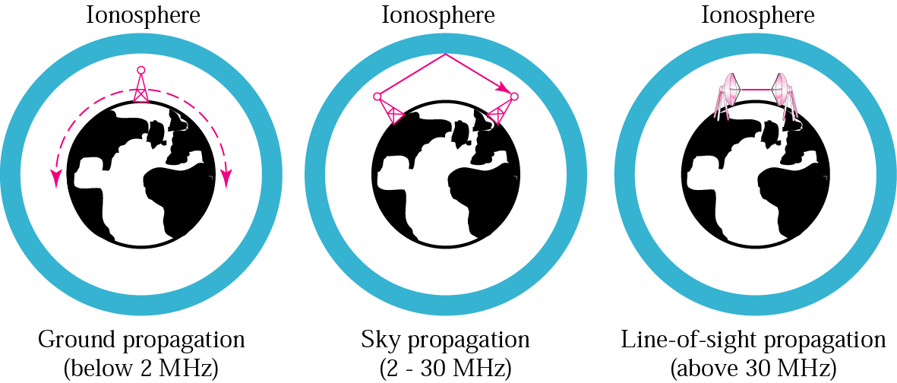
Propagation Methods

Slide 39
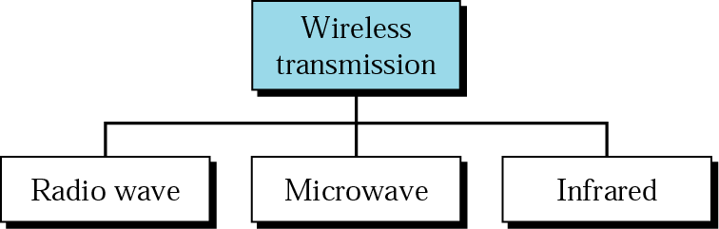
Wireless Transmission Waves

Slide 40
Radio wave
Radio waves are used for broadcast communications, such as radio, television, cordless phones, paging systems etc.
For radio waves, the sending and receiving antennas do not have to be aligned.
Radio waves are omnidirectional.
Radio waves cause interference.
Radio waves use omnidirectional antennas that send signals in all directions.

Slide 41
Microwave
Microwaves are used for unicast communication such as cellular telephones, satellite networks, and wireless LANs.
Microwaves are unidirectional.
For microwaves, the sending and receiving antennas need to be aligned.
Microwave propagation is LoS (line-of-sight).
Microwaves need unidirectional antennas that send out signals in one direction.

Slide 42
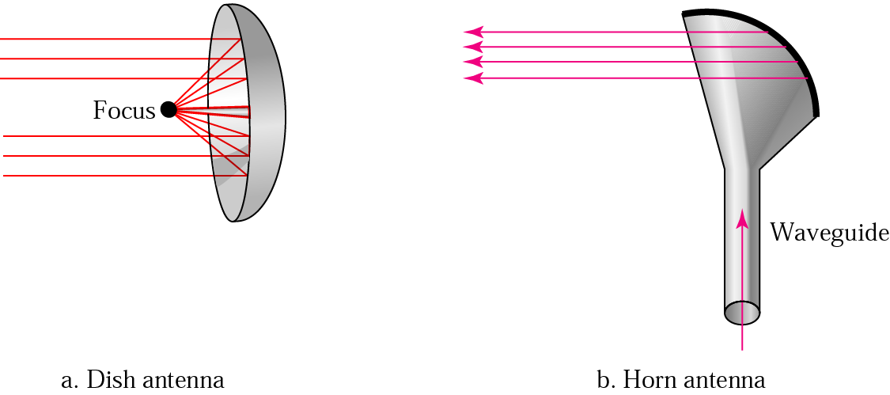
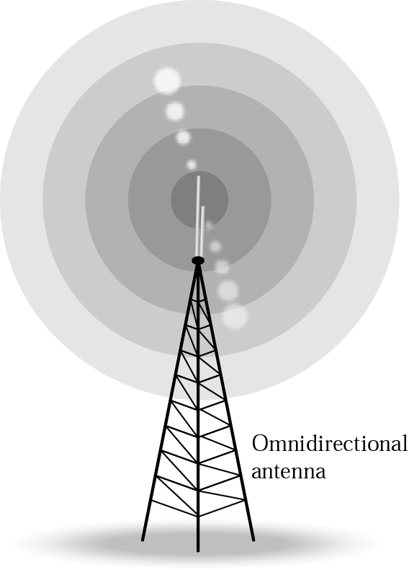
Omnidirectional & Unidirectional Antennas

Slide 43
Infrared
Infrared waves with frequencies from 300 GHz to 400 THz for short-range communication in a closed area using line-of-sight propagation
Having high frequencies, it cannot penetrate through walls
IrDA (Infrared Data Association) for standards
Example: IrDA port for wireless keyboard
  Originally defined a data rate of 75 kbps for a distance up to 8 m
  Recent standard for a data rate of 4 Mbps

